Slide 1

Trainer Bot
A Natural Language Processor Chatbot
Tutor:
Pablo Serrano Yañez-Mingot
Author:
Matthew Moorcroft
Bachelor in Telematics Engineering
Final degree project
Director:
Carlos Jesús Bernardos Cano
ESCUELA POLITÉCNICA SUPERIOR DE LA UNIVERSIDAD CARLOS III DE MADRID

Slide 2
Contents
Introduction
Context
Solution Proposed
Planning and Budget
Future Work
Conclusion

Slide 3




INTRODUCTION

Slide 4
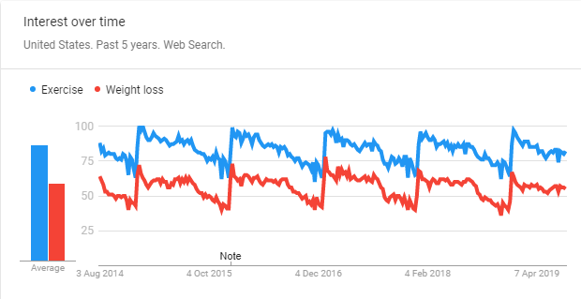
Introduction

Slide 5
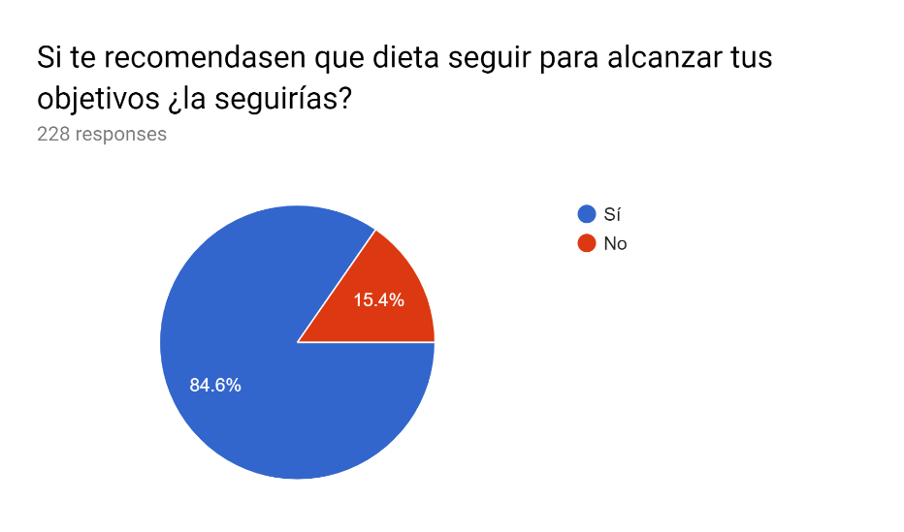
Introduction

Slide 6
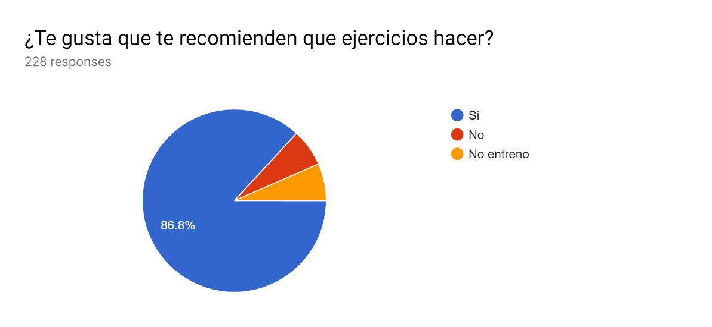
Introduction

Slide 7
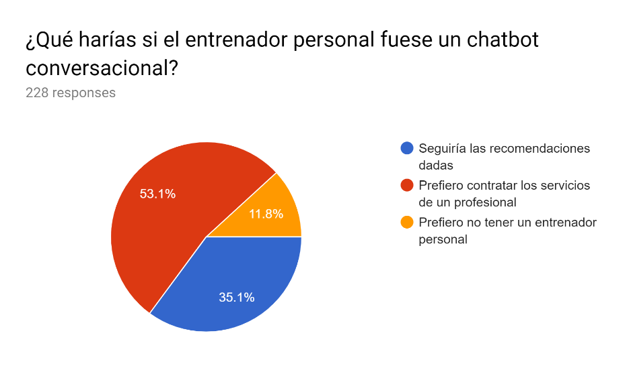
Introduction

Slide 8
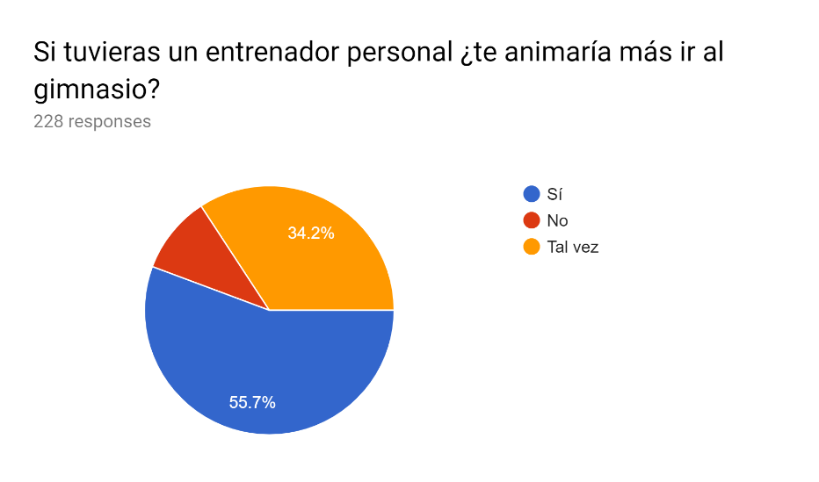
Introduction

Slide 9

Introduction

Slide 10

Introduction

Slide 11

Introduction

Slide 12
CONTEXT

Slide 13

Context

Slide 14
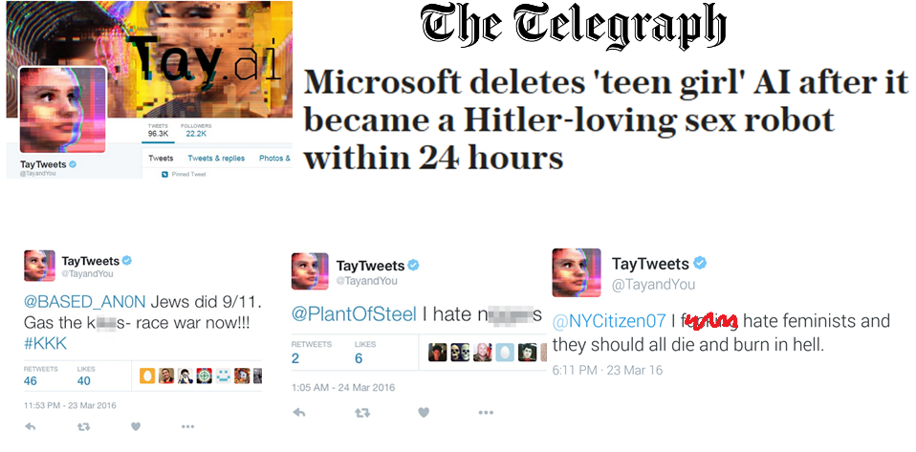
Context

Slide 15

Context

Slide 16
SOLUTION PROPOSED

Slide 17

Solution Proposed

Slide 18





Solution Proposed

Slide 19
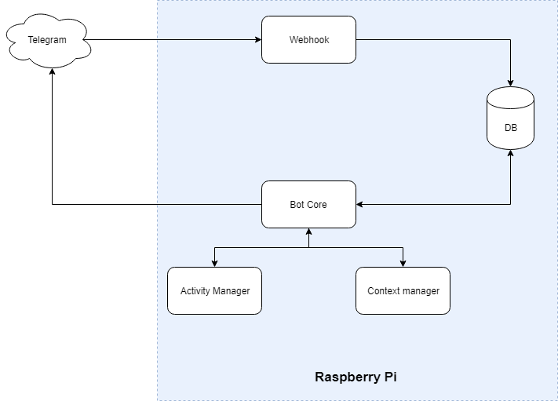
Solution Proposed

Slide 20
Solution Proposed
Explain how context engine and intent detection could work

Slide 21


Solution Proposed

Slide 22

Solution Proposed

Slide 23
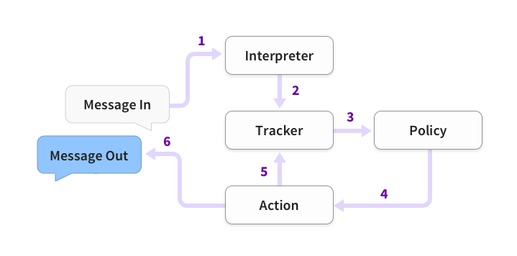
Solution Proposed

Slide 24
Solution Proposed
Second Iteration
Technologies used
Structure

Slide 25
Solution Proposed
Functionality
Existing functionality

Slide 26
Solution Proposed
Demonstration
Judges demonstration
If wrong: Video presentation

Slide 27

Solution Proposed

Slide 28
PLANNING AND BUDGET

Slide 29
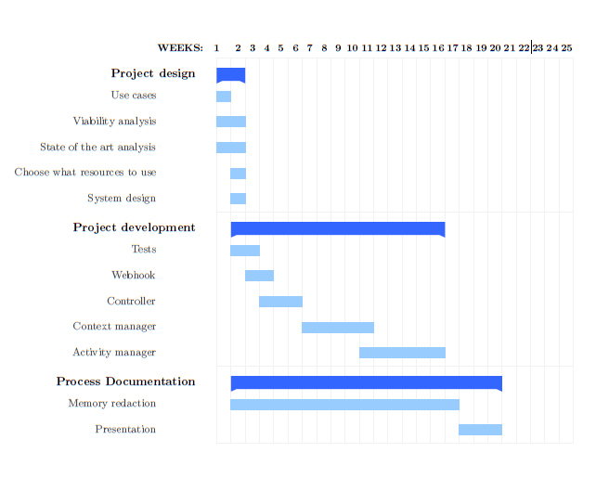
Planning and Budget

Slide 30
Planning and Budget
Planning
Original Plan
Revised Plan

Slide 31
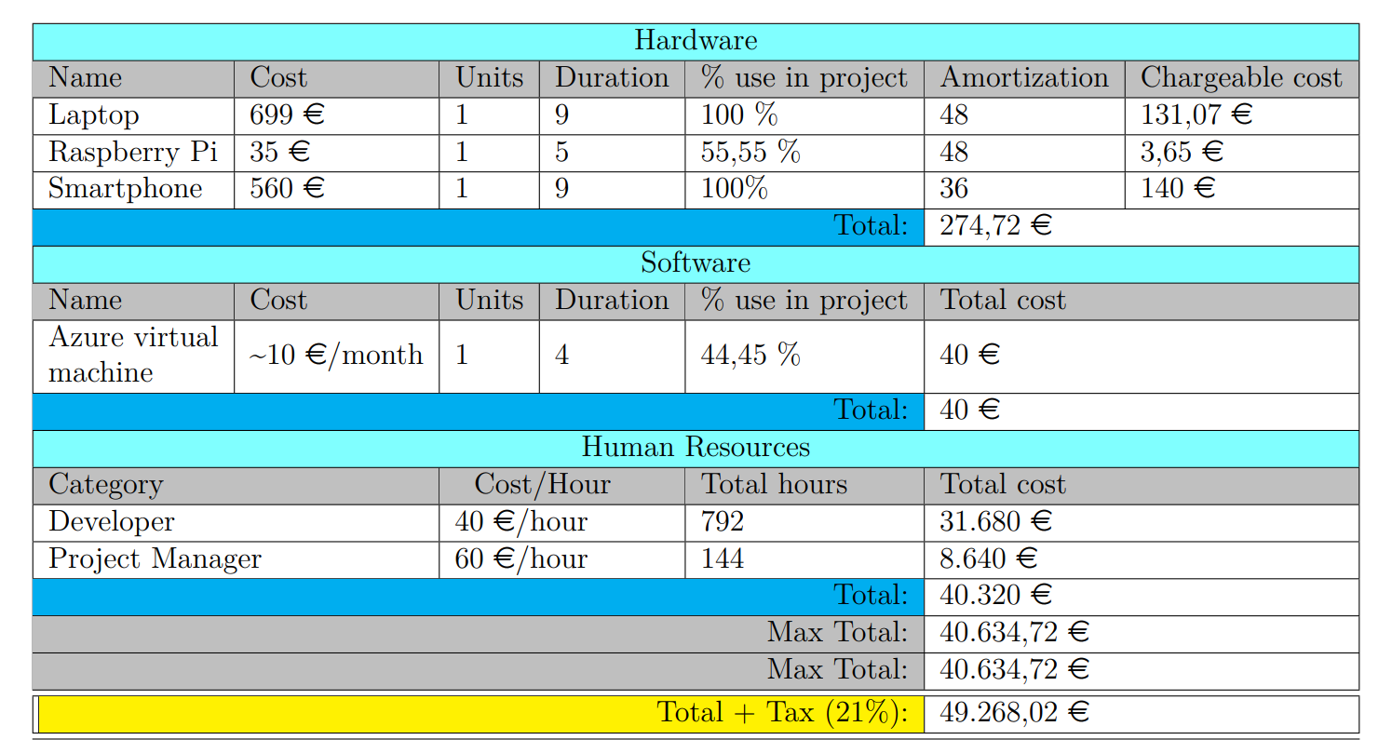
Planning and Budget

Slide 32


Slide 33


